Slide 1
Statistical Learning - Basic Statistics

Slide 2
Basic Statistics - Topics
Outline
Why Statistics and Big data
Statistics – methods
Classical definition and Types of stats
Some vital terms in stats
Sources and types of data and datasets
Data objects, attributes and its types
Descriptive Statistics outline
Data and Histogram
Central tendency and 3 Ms
‹#›

Slide 3
Basic Statistics - Topics(Contd.)
Measure of dispersion, Range, IQR
Descriptive statistics – Standard Deviation
Coefficient of variation
The Empirical Rule and Chebyshev Rule
The Five Number Summary and the Boxplot
Quantile Plot and Scatter Plot
Data Visualization
Visually Evaluating Correlation
Summary
Case Study

Slide 4
Why Statistics and Big data
Why statistics is so important
The significant events triggered the current meteoric growth in the use of analytical decision making and Statistics is central to all of them.
Event 1
Technological developments, Revolution of Internet and Social Networks, data generated from mobile phones produce large amount of data from which insights will be shifted.
The discovery of pattern and trends from these data for organizations will pay the way for improving profitability, understanding customer expectations so that they can gain competitive advantage in the market place.

Slide 5
Why Statistics and Big data (Contd.)
Event 2
Advances in enormous computing power to effectively process and analyse massive amounts of data.
Sophisticated and faster algorithms for solving problems.
Data visualization for Business intelligence and artificial intelligence.
Event 3
Large data storage capability.
Parallel and cloud computing have enabled business to solve large scale problems.

Slide 6
Why Statistics and Big data (Contd.)
Big Data
A set of data that cannot be managed, processed, or analysed with traditional software/algorithms within a reasonable amount of time.
Big data revolves around
Volume, Velocity, Variety, Value, Veracity

Slide 7
Statistics - Methods
Classification
Classification techniques helps in segmenting the customers into appropriate groups based on key characteristics.
For example, using appropriate statistical model, an organization could easily segment the customers into Long term customers, medium term customers, and Brand switchers.
Classification helps professionals understand the customer behaviour and position their products and brands using appropriate strategies.

Slide 8
Statistics - Methods
Pattern Recognition
“A picture is worth thousand words” and it reveals hidden pattern in the data that could be leveraged be retail professionals. Pattern recognition techniques include Histogram, Box Plot, Scatter plot and other visual analytics.
For example, histogram drawn for income of a particular class of customers may reveal a symmetrical bell curve pattern or may be left or right skewed.
Relationship between age and expenditure could be captured using a scatter plot.

Slide 9
Statistics - Methods
Association
Association analysis helps in determining which of the items go together. Association rules include a set of analytics that focuses on discovering relationships.
In this context, market basket analysis refers to an association rule that generates the probability for an outcome.
Association rules can be adapted by organizations to store layout, items bundling, discount and sales promotion decisions, and cross selling among others.

Slide 10
Statistics - Methods
Predictive Modeling
Both customer segmentation as well as identifying and targeting most profitable customers can be facilitated by predictive models.
Regression can be used for predicting the amount of expenditure on a particular product based on input variables income, age and gender.
Organizations can leverage on other advanced models that comprise Logistic Regression, and neural networks for predicting a target variable as well as classifying and predicting into which group the consumer belongs to.

Slide 11
Classical definition and Types of stats
“By statistics, we mean methods specially adopted to the elucidation of quantitative data affected to a marked extent by multiplicity of causes”.
It is interesting to see what Thomas Davenport means by Business Analytics and note the similarities and dissimilarities between the two.
Business Analytics (BA) can be defined as the broad use of data and quantitative analysis for decision making within organizations.

Slide 12
Classical definition and Types of stats
Types of statistics
Descriptive statistics is concerned with Data summarization, Graphs/Charts, and tables
Inferential statistics is a method used to talk about a Population parameter from a sample

Slide 13
Some vital terms in stats
Population, Parameter, Sample, Statistic
A population is the universe of possible data for a specified object.
A parameter is a numerical value associated with a population.
A sample is a selection of observations from a population
A Statistic is a numerical value associated with an observed sample.

Slide 14
Sources and Types of data
Data Sources
Primary Data are collected by organization itself for a particular purpose. The benefits of primary data are that they fits the needs exactly and reliable.
Secondary Data are collected by other organizations or for other purposes. Any data, which are not collected by the organization for the specified purpose, are secondary data.

Slide 15
Sources and Types of data
Types of Data
Qualitative data are non numeric in nature and cannot be measured.
Quantitative data are numerical in nature and can be measured and can be classified into two: discrete and continuous.
Discrete type can take only certain values, and there are discontinuities between values.
Continuous type can take any value within a specific interval.

Slide 16
Sources and Types of data
Types of datasets
Record
Graph and network
Ordered
Spatial, image and Multimedia

Slide 17
Data objects, attributes and its types
Data objects
Data sets are made up of data objects.
A data object represents an entity.
Data objects are described by attributes.
Examples:
sale database : customers, sales
medical database: patients, treatments

Slide 18
Data objects, attributes and its types
Attributes
Attribute: a data field, representing a characteristic or feature of a data object. Example: customer_ID, name, address
Types:
Nominal
Binary
Ordinal
numeric

Slide 19
Data objects, attributes and its types
Attribute types
1. Nominal: categories, states or “names of things”
Hair_color = {black, brown, grey}
marital status, occupation, ID
2. Binary
Symmetric binary
Asymmetric binary
3. Ordinal

Slide 20
Descriptive Statistics outline
Outline
Raw data
Frequency Distribution - histograms
Cumulative frequency distribution
Measures of central tendency
Mean, median, mode
Measures of dispersion
Range, IQR, standard deviation, coefficient of variation
normal distribution
Five number summary, boxplots, QQ plots
. Visualization: scatter plot matrix
Correlation analysis

Slide 21
Data and Histogram
Raw data
Raw data represent numbers and facts in the original format in which the data have been collected. We need to convert the raw data into information for decision making.
Frequency distribution
Frequency distribution focuses on classifying raw data into information. It is widely used data reduction technique in descriptive statistics.

Slide 22
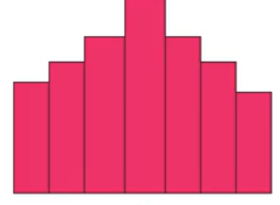
Histogram
Histogram is a snapshot of the frequency distribution.
histogram depicts the pattern of the distribution emerging from the characteristic being measured.

Slide 23
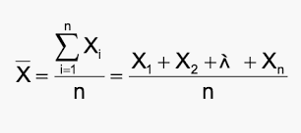
Central tendency and 3 Ms
Whenever you measure things of the same kind, a fairly large number of such measurements will tend to cluster around the middle value. Such a value is called a measure of “Central tendency”
Mean
The statistical mean refers to the mean or average that is used to derive the central tendency of the data.

Slide 24

Median
The middle value that separates the higher half from the lower half of the data set. The median and the mode are the only measures of central tendency that can be used for original data, in which values are ranked relative to each other but are not measured absolutely.

Slide 25
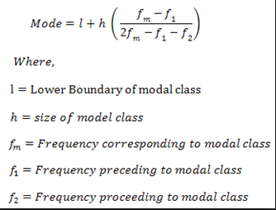
Mode
The most frequent value in the data set. This is the only central tendency measure that can be used with nominal data, which have purely qualitative category assignments.

Slide 26
Measure of dispersion, Range, IQR
Measures of dispersion
Measure of dispersion indicate how large the spread of distribution in around the central tendency.
Range
Range is the simplest of all measures of dispersion. It is calculated as the difference between maximum and minimum value in dataset.
range = X(maximum) - X (minimum)

Slide 27
IQR
Q1 divides the values between minimum and Q2 into 2 equal half. In other words Q1 is that value which has 25% values below it and rest above.
IQR = Q3 - Q1

Slide 28

Descriptive statistics – Standard Deviation
Interpreting variance (a squared term) is not intuitive. Instead we under root it to get Standard deviation which has the same units as variable.
Standard deviation, is a measure of average spread i.e., on an average what is the difference between any data point and the central value of the variable.

Slide 29

Coefficient of variation
Coefficient variation is defined as ratio of standard deviation to mean.
In symbolic form,

Slide 30
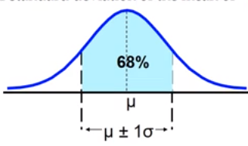
The Empirical Rule and Chebyshev Rule
The Empirical rule
The empirical rule approximates the variation of data in a bell-shaped distribution.
Approximately 68% of the data in a bell shaped distribution is within 1 standard deviation of the mean.

Slide 31
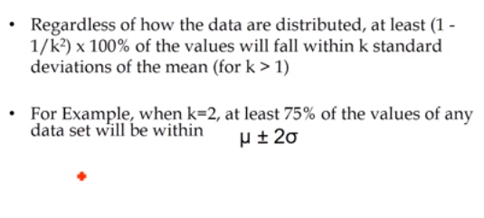
The Empirical Rule and Chebyshev Rule
Chebyshev Rule

Slide 32
The Five Number Summary
The five numbers that help describe the center, spread and shape of data are:
^{X}smallest
First Quartile (Q₁)
Median (Q₂)
Third Quartile (Q₃)
^{X}largest

Slide 33
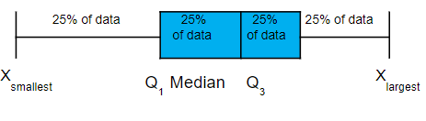
Five Number Summary and The Boxplot
The Boxplot: A Graphical display of the data based on the five-number summary:
Example:

Slide 34
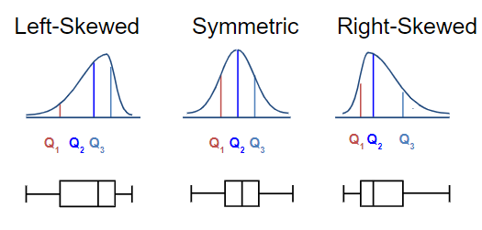
Distribution Shape and the Boxplot

Slide 35
Graphic Displays of Basic Statistical Descriptions
Boxplot: graphic display of five-number summary
Histogram: x-axis are values, y-axis repres. frequencies
Quantile plot: each value x_{i} is paired with f_{i} indicating that approximately 100 f_{i} % of data are ≤ x_{i}
Quantile-quantile (q-q) plot: graphs the quantiles of one univariant distribution against the corresponding quantiles of another
Scatter plot: each pair of values is a pair of coordinates and plotted as points in the plane

Slide 36
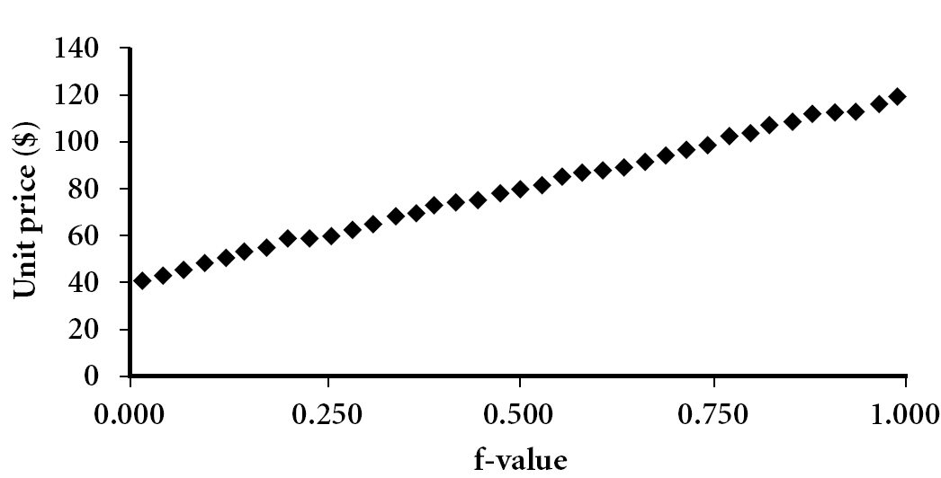
Quantile Plot
Displays all of the data (allowing the user to assess both the overall behavior and unusual occurrences)
Plots quantile information
For a data x_{i} data sorted in increasing order, f_{i} indicates that approximately 100 f_{i}% of the data are below or equal to the value x_{i}

Slide 37
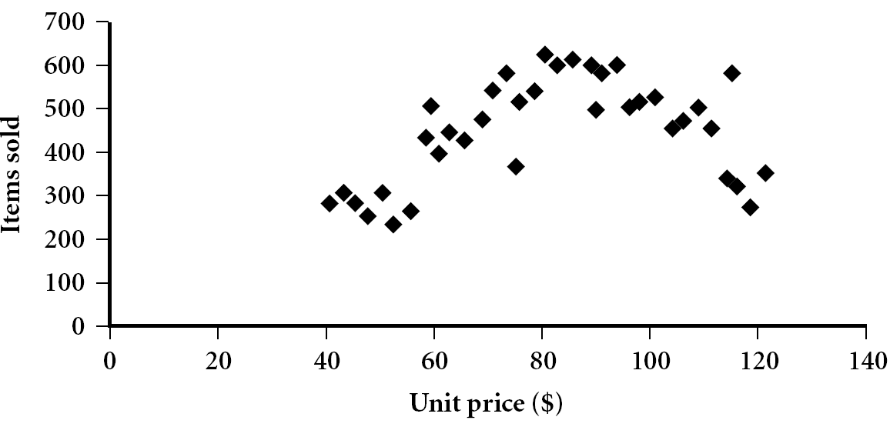
Scatter Plot
Provides a first look at bivariate data to see clusters of points, outliers, etc
Each pair of values is treated as a pair of coordinates and plotted as points in the plane

Slide 38
Data Visualization
Why data visualization?
Gain insight into an information space by mapping data onto graphical primitives
Provide qualitative overview of large data sets
Search for patterns, trends, structure, irregularities, relationships among data
Help find interesting regions and suitable parameters for further quantitative analysis
Provide a visual proof of computer representations derived
Categorization of visualization methods:
Pixel-oriented visualization techniques
Geometric projection visualization techniques
Icon-based visualization techniques
Hierarchical visualization techniques
Visualizing complex data and relations

Slide 39
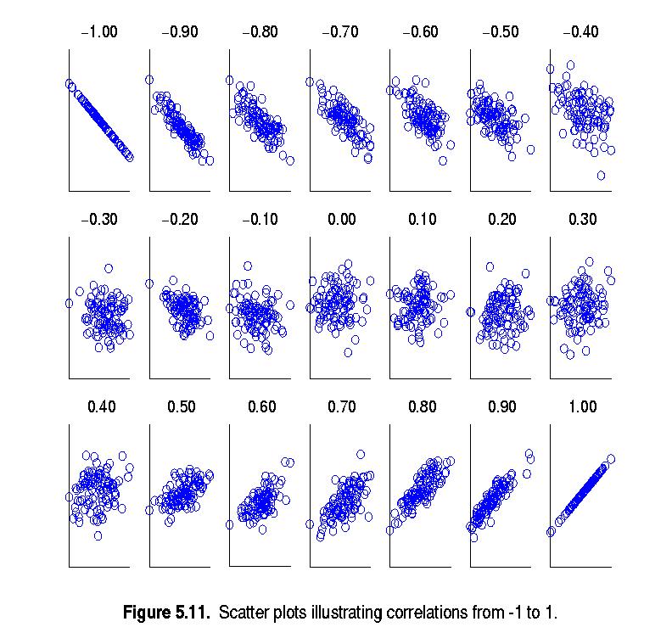
Visually Evaluating Correlation
Scatter plots showing the similarity from -1 to 1

Slide 40
Summary
Histograms
Measures of central tendency: mean, mode, median
Measures of dispersion: range, IQR, variance, std deviation, coefficient of variation.
Normal distribution, Chebyshev Rule.
Five number summary, boxplots, QQ plots, Quantile plot, scatter plot.
Visualization: scatter plot matrix, parallel coordinates.
Correlation analysis.

Slide 41
Case Study
Churn in Telecom’s dataset-
The dataset is about telecom industry which tells about the number of customers who churned the service. It consists of 3333 observations having 21 variables. We have to predict which customer is going to churn the service.
Dataset -
The dataset contains State, Account Length, area code, phone number, international plan, voice mail plan and important variables like call charges, international call charges, customer service calls, etc.
For Reference: https://www.kaggle.com/blastchar/telco-customer-churn

Slide 42
Steps Followed
Objective - Predict behavior to retain customers. You can analyze all relevant customer data and develop focused customer retention programs.
Steps-
Import pandas, numpy, seaborn, matplotlib.pyplot packages
Get the data
Calculate histogram for minutes per day spent by customers.
How do we categorize the churner and the non-churner for the time spent on day calls?
Find the number of customers who did opt for voicemail plan.
Create a boxplot for a categorical variable and continuous variable.
How to pivot information using python for categorical values?
Understand the correlation between all variables.
Plot a distplot to check total night calls.
Calculate area wise churner or non-churner

Slide 43


AIML @WORK
PGPAIML @ Great Learning
Enabling Learners to Apply the AI/ML Concepts at Work
Apply AIML at your workplace to gain some instant benefits:
Get noticed by your management with your outstanding analysis backed by data science.
Create an impact in your organization by taking up small projects/initiatives to solve critical issues using data science.
Network with members from the data science vertical of your organization and seek opportunities to contribute in small projects.
Share your success stories with us and the world to position yourself as a subject matter expert in data science.
AIML Operations | AIMLAW
@Great Learning Proprietary Content. All rights reserved. Unauthorized use or distribution prohibited

Slide 44


Questions?

